Slide 1
CHAPTERS 7-8

Slide 2
Chiastic Paralleism in the story of Noah and the flood (Genesis 6.10-9.19):
A Noah (10a)
B Shem, Ham, and Japheth (10b)
C Ark to be built (14-16)
D Flood announced (17)
E Covenant with Noah (18-20)
F Food in the Ark (21)
G Command to enter the Ark (7.1-3)
H 7 days waiting for flood (4-5)
I 7 days waiting for flood (7-10)
J Entry to ark (11-15)
K Yahweh shuts Noah in (16)
L 40 days flood (17a)
M Waters increase (17b-18)
N Mountains covered (18-20)
O 150 days waters prevail (21-24)
P GOD REMEMBERS NOAH (8.1)
O’ 150 days waters abate (3)
N’ Mountain tops become visible (4-5)
M’ Waters abate (6)
L’ 40 days (end of) (6a)
K’ Noah opens window of ark (6b)
J’ Raven and dove leave ark (7-9)
I’ 7 days waiting for waters to subside (10-11)
H’ 7 days waiting for waters to subside (12-13)
G’ Command to leave the ark (15-17)
F’ Food outside the ark (9.1-4)
E’ Covenant with all flesh (8-10)
D’ No flood in future (11-17)
C’ Ark (18a)
B’ Shem, Ham, Japheth (18b)
A’ Noah (19)
THE FLOOD NARRATIVE

Slide 3
THE FLOOD - CH. 7
v.1 : The Lord speaks to Noah
vs. 2-3 : Clean & unclean animals
vs. 4-5 : God’s warning and Noah’s response
Ch 7 Vs. 4-5 ESV
“4 For in seven days I will send rain on the earth forty days and forty nights, and every living thing[c] that I have made I will blot out from the face of the ground.” 5 And Noah did all that the Lord had commanded him.”

Slide 4
THE FLOOD – CH. 7
^{Hebrews 11: 7 ESV}
7 “By faith Noah, being warned by God concerning events as yet unseen, in reverent fear constructed an ark for the saving of his household. By this he condemned the world and became an heir of the righteousness that comes by faith.”

Slide 5
THE FLOOD – CH. 7
vs. 6-7 : Noah is 600 when the flood begins
vs. 8-9 : The animals enter the ark
v. 10-13 : Flooding begins. Rains for 40 days and nights
vs. 16 : God’s fatherly act of care at the brink of judgement

Slide 6
THE FLOOD – CH. 8
Ephesians 2:8-9 ESV
8 "For by grace you have been saved through faith. And this is not your own doing; it is the gift of God, 9 not a result of works, so that no one may boast."

Slide 7
THE FLOOD – CH. 7
vs. 17-18: Flooding increases, ark begins to float
vs. 19-20 : All mountains covered by flood
vs. 21-23 : “All flesh died…” except for those on the ark.

Slide 8
THE FLOOD – CH. 8
v. 1 : “But God remembered Noah”
vs. 2-3 : The rains stop, waters recede
vs. 4-5 : The ark comes to rest on a mountain

Slide 9
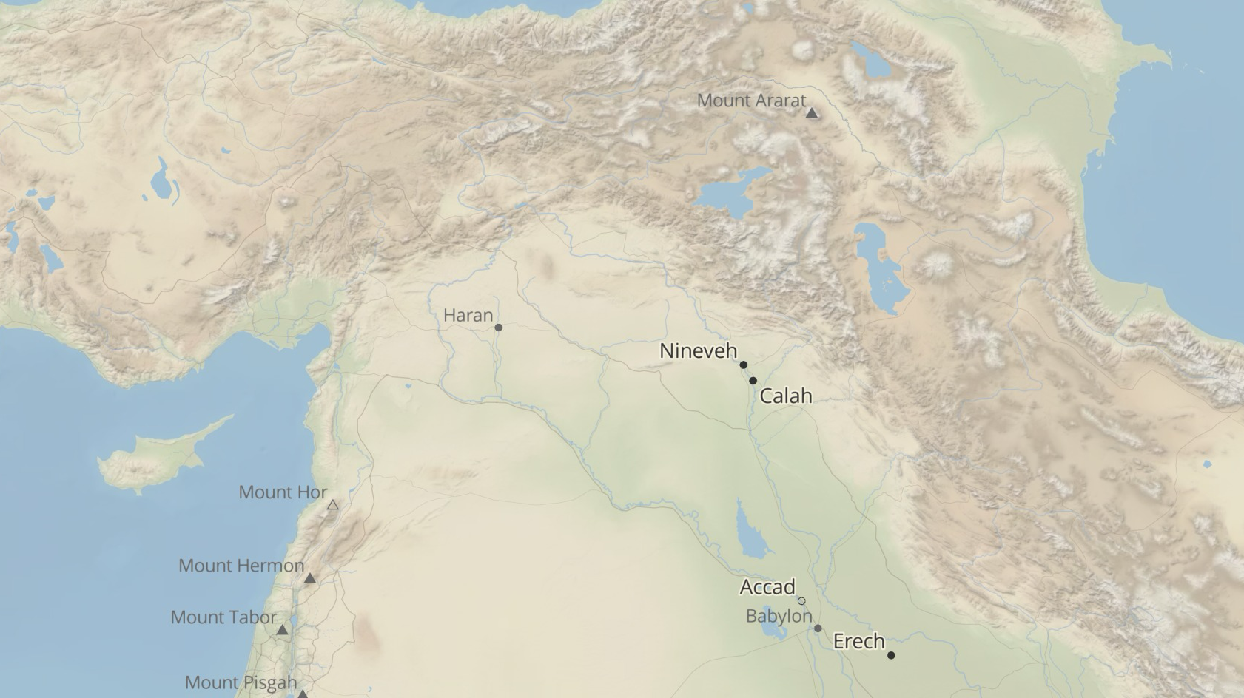
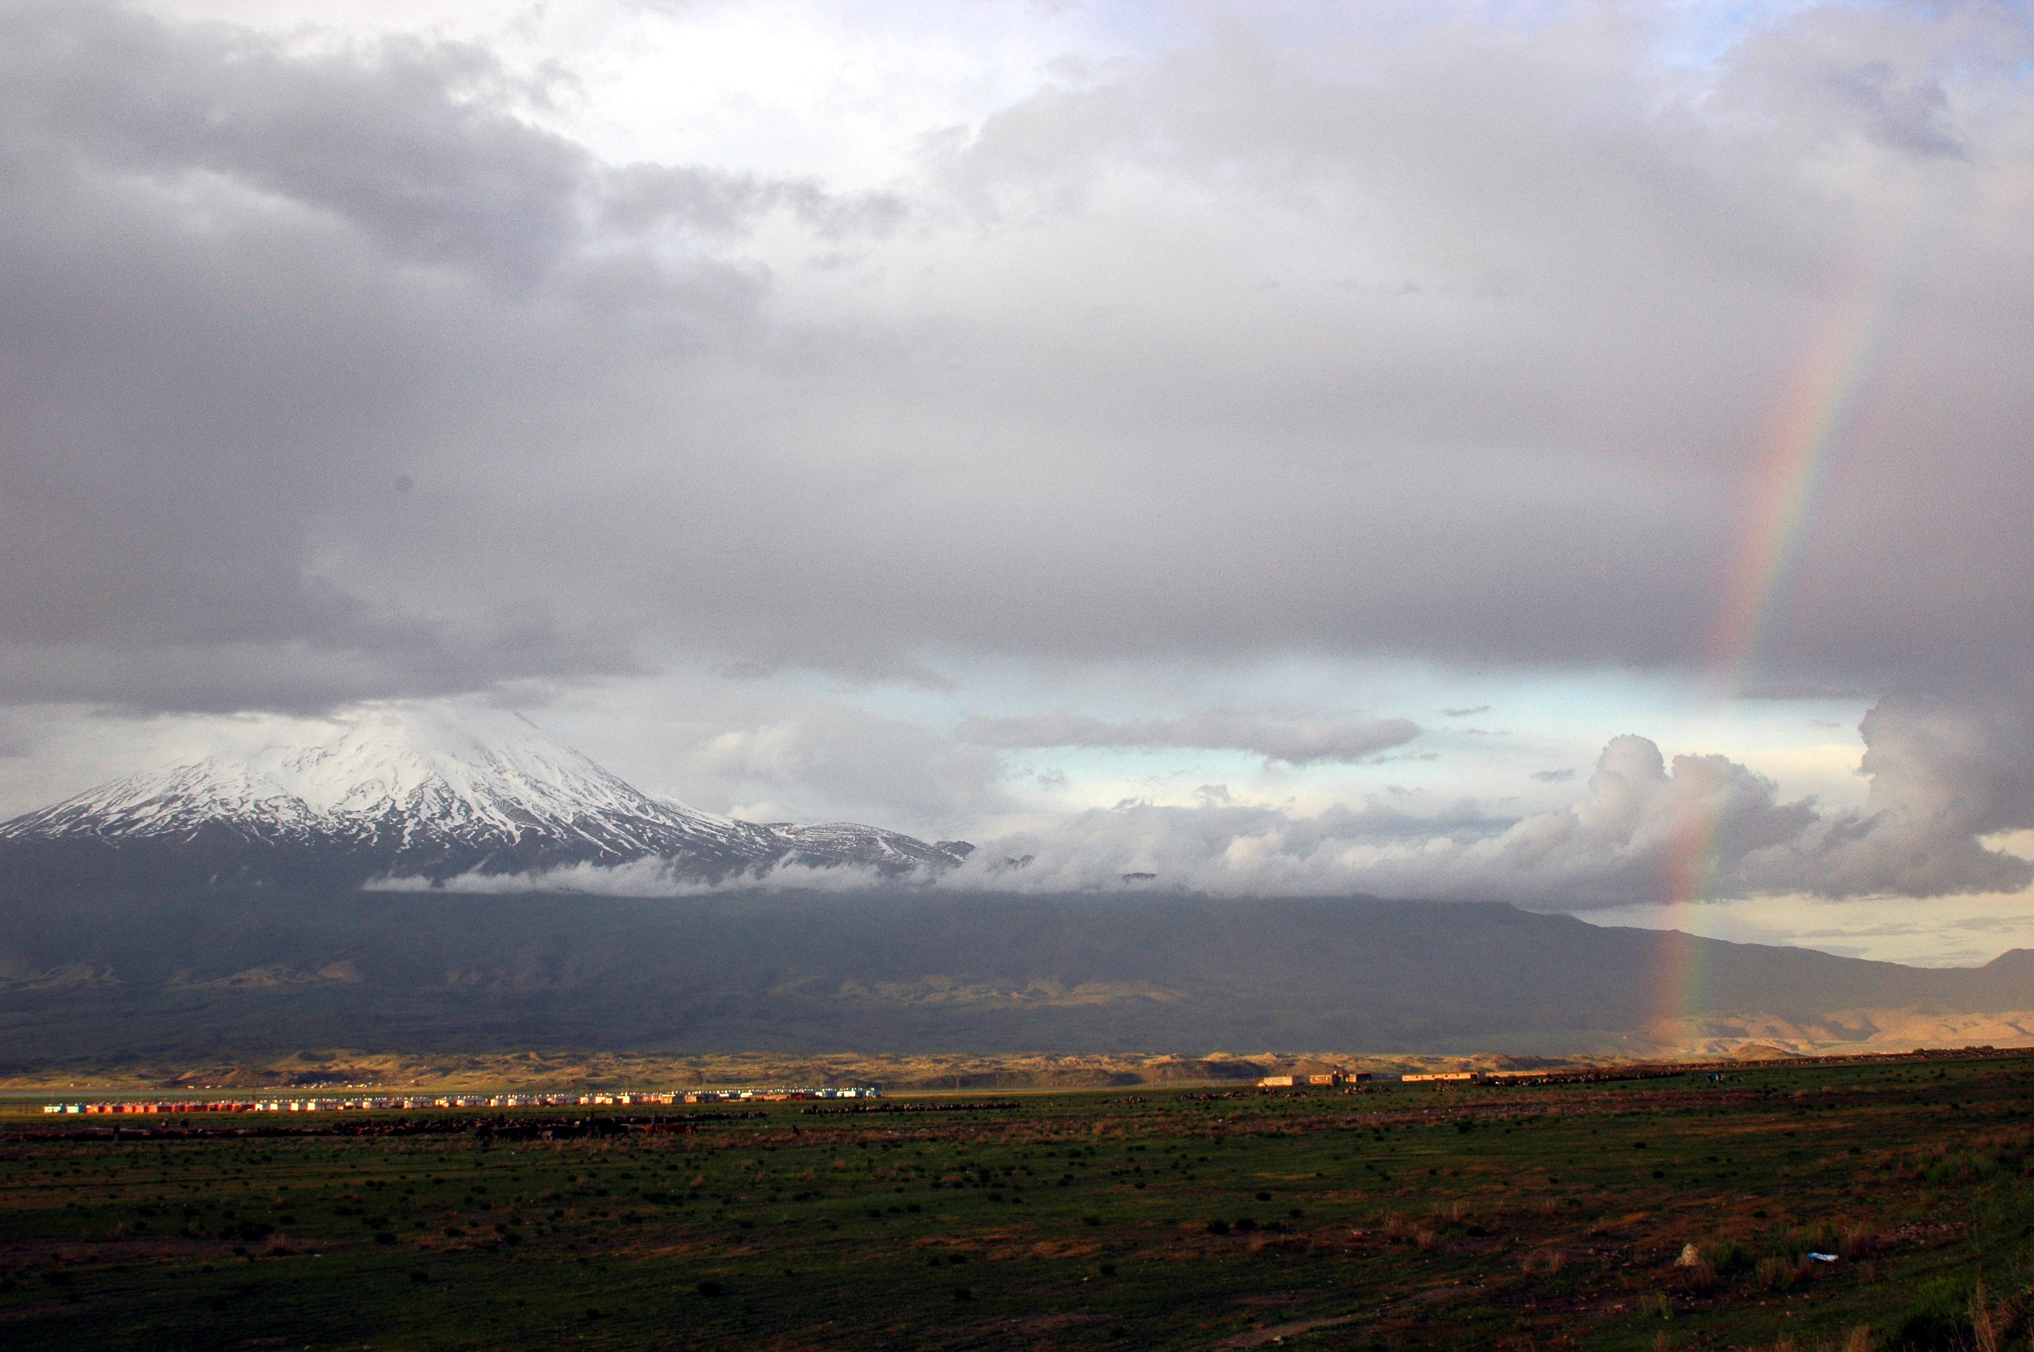
Mt. Ararat, courtesy of Leon Mauldin

Slide 10
THE FLOOD – CH. 8
vs. 6-12 : Noah’s resourcefulness and patience
vs. 15-17 : “Go out from the ark”
Vs. 20-22 : Noah sacrifices to the Lord, the Lord is pleased

Slide 11
THE FLOOD – CH. 8
1st Peter 3:18-21 ESV
18 For Christ also suffered once for sins, the righteous for the unrighteous, that he might bring us to God, being put to death in the flesh but made alive in the spirit, 19 in which he went and proclaimed to the spirits in prison, 20 because they formerly did not obey, when God's patience waited in the days of Noah, while the ark was being prepared, in which a few, that is, eight persons, were brought safely through water. 21 Baptism, which corresponds to this, now saves you, not as a removal of dirt from the body but as an appeal to God for a good conscience, through the resurrection of Jesus Christ

Slide 12
LESSONS FROM THE FLOOD
God is patient
God is faithful to his word
God is sending judgement again, but not in the form of water
God will save the righteous again like he saved Noah

Slide 13
LESSONS FROM THE FLOOD
2nd Peter 3:5-7 ESV
5 For they deliberately overlook this fact, that the heavens existed long ago, and the earth was formed out of water and through water by the word of God, 6 and that by means of these the world that then existed was deluged with water and perished. 7 But by the same word the heavens and earth that now exist are stored up for fire, being kept until the day of judgment and destruction of the ungodly.

Slide 14
LESSONS FROM THE FLOOD
2nd Peter 3:11-13 ESV
11 Since all these things are thus to be dissolved, what sort of people ought you to be in lives of holiness and godliness, 12 waiting for and hastening the coming of the day of God, because of which the heavens will be set on fire and dissolved, and the heavenly bodies will melt as they burn! 13 But according to his promise we are waiting for new heavens and a new earth in which righteousness dwells.

Slide 15
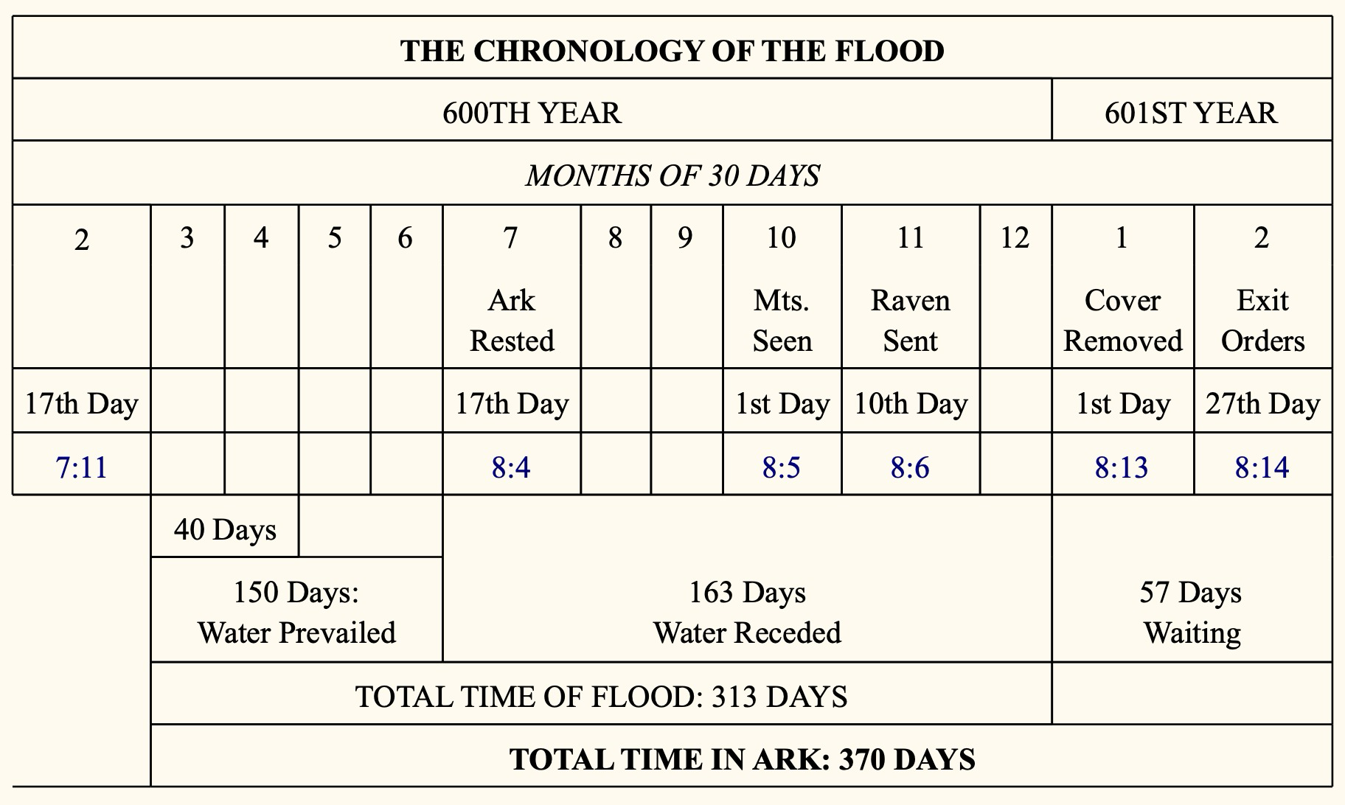

Slide 16
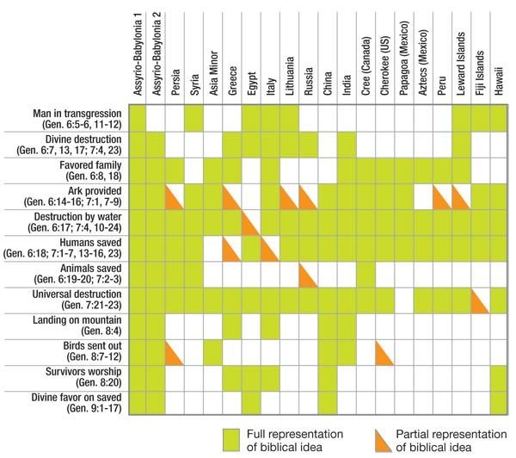
FLOOD STORIES IN OTHER CULTURES
Source: B.C. Nelson, The Deluge Story in Stone, Appendix 11, Flood Traditions, Figure 38, Augsburg, Minneapolis, 1931.

