Slide 1
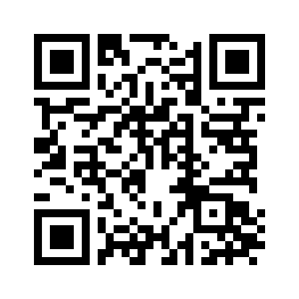
CHAPTER 16

Slide 2
Hagar & Ishmael
Genesis 11:30 (ESV)
³⁰Now Sarai was barren; she had no child.

Slide 3
Hagar & Ishmael
Genesis 16:2 (ESV)
²And Sarai said to Abram, “Behold now, the Lord has prevented me from bearing children. Go in to my servant; it may be that I shall obtain children by her.” And Abram listened to the voice of Sarai.

Slide 4
Hagar & Ishmael
Genesis 16:4–6 (ESV)
⁴ And he went in to Hagar, and she conceived. And when she saw that she had conceived, she looked with contempt on her mistress. ⁵ And Sarai said to Abram, “May the wrong done to me be on you! I gave my servant to your embrace, and when she saw that she had conceived, she looked on me with contempt. May the Lord judge between you and me!” ⁶ But Abram said to Sarai, “Behold, your servant is in your power; do to her as you please.” Then Sarai dealt harshly with her, and she fled from her.

Slide 5
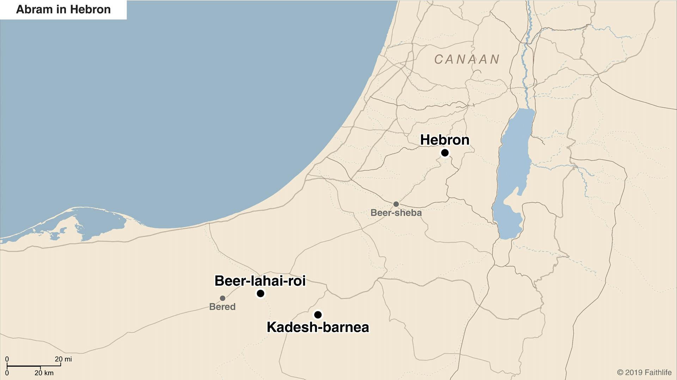
Hagar & Ishmael

Slide 6
Hagar & Ishmael
Genesis 16:11–13 (ESV)
¹¹ And the angel of the Lord said to her, “Behold, you are pregnant and shall bear a son. You shall call his name Ishmael, because the Lord has listened to your affliction. ¹² He shall be a wild donkey of a man, his hand against everyone and everyone’s hand against him, and he shall dwell over against all his kinsmen.” ¹³ So she called the name of the Lord who spoke to her, “You are a God of seeing,” for she said, “Truly here I have seen him who looks after me.”

Slide 7
Hagar & Ishmael
Galatians 4:21–23 (ESV)
²¹ Tell me, you who desire to be under the law, do you not listen to the law? ²² For it is written that Abraham had two sons, one by a slave woman and one by a free woman. ²³ But the son of the slave was born according to the flesh, while the son of the free woman was born through promise.

