Slide 1
CHAPTER 21

Slide 2
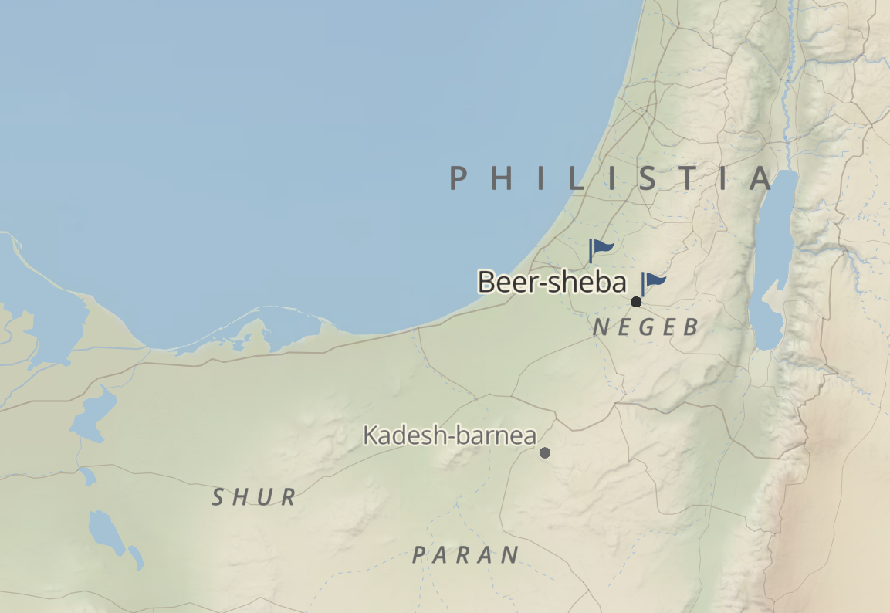
Setting for Chapter 21

Slide 3
CHAPTER 21 – Isaac is Born
Genesis 21:1-3 (ESV)
The Lord visited Sarah as he had said, and the Lord did to Sarah as he had promised. 2 And Sarah conceived and bore Abraham a son in his old age at the time of which God had spoken to him. 3 Abraham called the name of his son who was born to him, whom Sarah bore him, Isaac.

Slide 4
CHAPTER 21 – Isaac and Ishmael
Genesis 21:9-12 (ESV)
9 But Sarah saw the son of Hagar the Egyptian, whom she had borne to Abraham, laughing. 10 So she said to Abraham, “Cast out this slave woman with her son, for the son of this slave woman shall not be heir with my son Isaac.” 11 And the thing was very displeasing to Abraham on account of his son. 12 But God said to Abraham, “Be not displeased because of the boy and because of your slave woman. Whatever Sarah says to you, do as she tells you, for through Isaac shall your offspring be named.

Slide 5
CHAPTER 21 – Isaac and Ishmael
Galatians 4:21-24 (ESV)
21 Tell me, you who desire to be under the law, do you not listen to the law? 22 For it is written that Abraham had two sons, one by a slave woman and one by a free woman. 23 But the son of the slave was born according to the flesh, while the son of the free woman was born through promise. 24 Now this may be interpreted allegorically: these women are two covenants. One is from Mount Sinai, bearing children for slavery; she is Hagar.

Slide 6
CHAPTER 21 – Isaac and Ishmael
Galatians 4:25-28 (ESV)
25 Now Hagar is Mount Sinai in Arabia; she corresponds to the present Jerusalem, for she is in slavery with her children. 26 But the Jerusalem above is free, and she is our mother. 27 For it is written,“Rejoice, O barren one who does not bear; break forth and cry aloud, you who are not in labor! For the children of the desolate one will be more than those of the one who has a husband.”
28 Now you, brothers, like Isaac, are children of promise.

Slide 7
CHAPTER 21 – Isaac and Ishmael
Galatians 4:29-31 (ESV)
29 But just as at that time he who was born according to the flesh persecuted him who was born according to the Spirit, so also it is now. 30 But what does the Scripture say? “Cast out the slave woman and her son, for the son of the slave woman shall not inherit with the son of the free woman.” 31 So, brothers, we are not children of the slave but of the free woman.

Slide 8
CHAPTER 21 – Children of Promise
Romans 9:6-9 (ESV)
6 But it is not as though the word of God has failed. For not all who are descended from Israel belong to Israel, 7 and not all are children of Abraham because they are his offspring, but “Through Isaac shall your offspring be named.” 8 This means that it is not the children of the flesh who are the children of God, but the children of the promise are counted as offspring. 9 For this is what the promise said: “About this time next year I will return, and Sarah shall have a son.”

Slide 9
CHAPTER 21 – Abraham and Abimelech
Genesis 21:22-24 (ESV)
22 At that time Abimelech and Phicol the commander of his army said to Abraham, “God is with you in all that you do. 23 Now therefore swear to me here by God that you will not deal falsely with me or with my descendants or with my posterity, but as I have dealt kindly with you, so you will deal with me and with the land where you have sojourned.” 24 And Abraham said, “I will swear.”

Slide 10
CHAPTER 21 – Abraham and Abimelech
Genesis 21:33 (ESV)
Abraham planted a tamarisk tree in Beersheba and called there on the name of the Lord, the Everlasting God.

