Slide 1
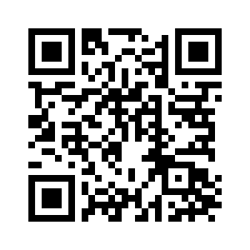
CHAPTER 22

Slide 2
The Testing of Abraham
Genesis 22:1–2 (ESV)
¹After these things God tested Abraham and said to him, “Abraham!” And he said, “Here I am.”
²He said, “Take your son, your only son Isaac, whom you love, and go to the land of Moriah, and offer him there as a burnt offering on one of the mountains of which I shall tell you.”

Slide 3
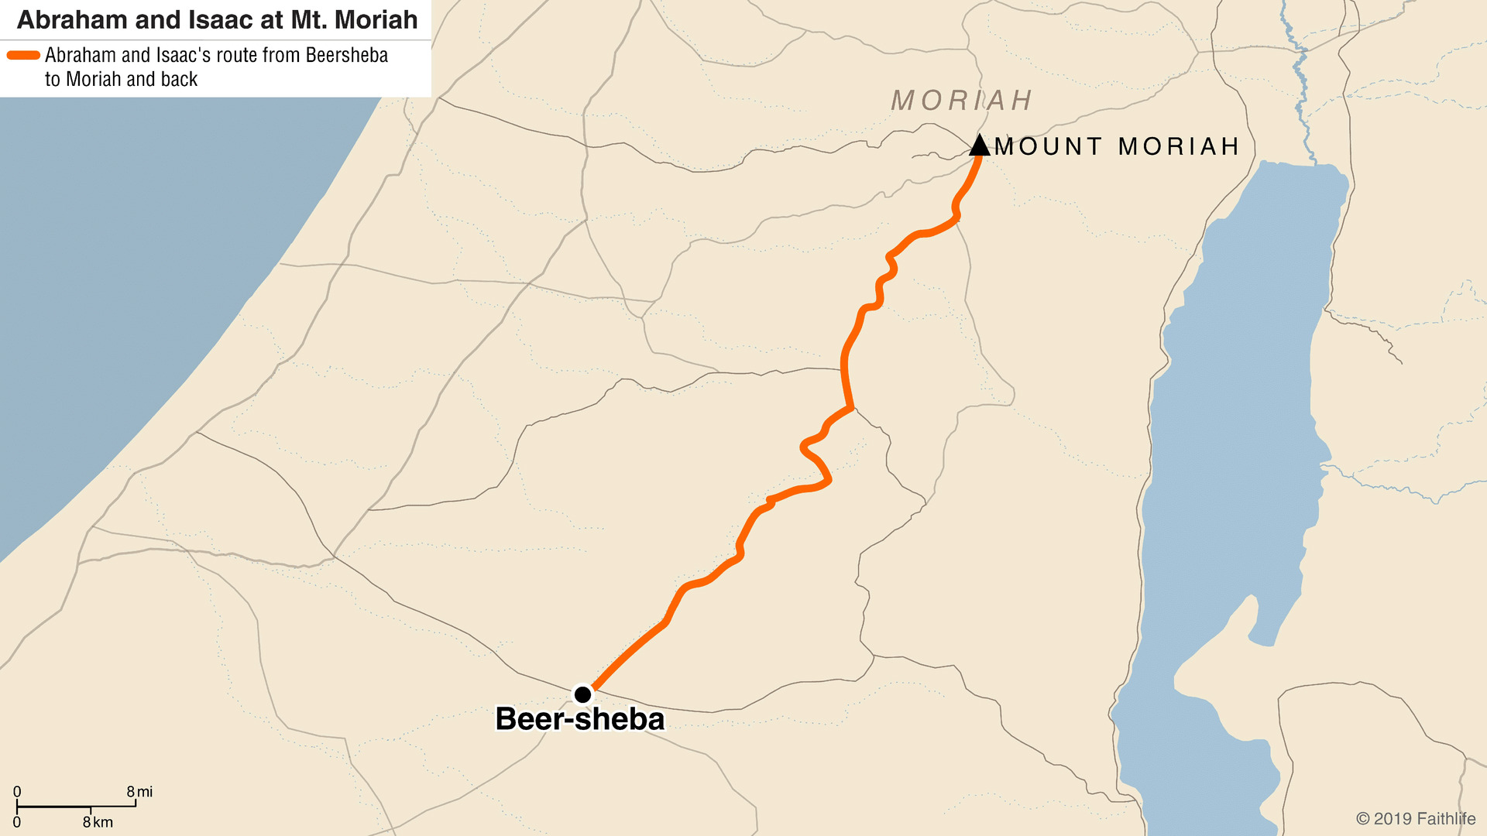
The Testing of Abraham

Slide 4
The Testing of Abraham
Genesis 22:5 (ESV)
⁵Then Abraham said to his young men, “Stay here with the donkey; I and the boy will go over there and worship and come again to you.”

Slide 5
The Testing of Abraham
Genesis 22:7–8 (ESV)
⁷And Isaac said to his father Abraham, “My father!” And he said, “Here I am, my son.” He said, “Behold, the fire and the wood, but where is the lamb for a burnt offering?”
⁸Abraham said, “God will provide for himself the lamb for a burnt offering, my son.” So they went both of them together.

Slide 6
The Testing of Abraham
Genesis 22:12 (ESV)
¹²He said, “Do not lay your hand on the boy or do anything to him, for now I know that you fear God, seeing you have not withheld your son, your only son, from me.”

Slide 7
The Testing of Abraham
Genesis 22:16–18 (ESV)
¹⁶and said, “By myself I have sworn, declares the Lord, because you have done this and have not withheld your son, your only son,
¹⁷I will surely bless you, and I will surely multiply your offspring as the stars of heaven and as the sand that is on the seashore. And your offspring shall possess the gate of his enemies,
¹⁸and in your offspring shall all the nations of the earth be blessed, because you have obeyed my voice.”

Slide 8
Foreshadowing Calvary
Isaac was Abraham’s “only son” (vss. 2,12); Jesus is the “only begotten Son” of God (John 3.16).
Abraham believed that God would raise Isaac from the dead (vs. 5; Hebrews 11.17-19); God did raise His Son from the dead (Acts 2.24).
Abraham laid the wood on Isaac (vs. 6); the cross was laid on Jesus (John 19.17).

Slide 9
Foreshadowing Calvary
Isaac demonstrated faith and submission to the will of his father (vss. 7-9); Jesus faithfully submitted to the will of His Father (Matthew 26.39).
God provided a substitute offering in place of Isaac (vs. 13); Jesus is the substitute sacrifice for us (Isaiah 53.6; Matthew 20.28; 26.28).
Abraham believed that the Lord would provide and He did (vss. 8,14)! Jesus is the fulfillment of God’s provision.

Slide 10
God’s People Are Tested
1 Peter 1:6–7 (ESV)
⁶In this you rejoice, though now for a little while, if necessary, you have been grieved by various trials,
⁷so that the tested genuineness of your faith—more precious than gold that perishes though it is tested by fire—may be found to result in praise and glory and honor at the revelation of Jesus Christ.

